Slide 1
Application Design – Recap

Slide 2
Recap …….

Slide 3
What is a web service?
CONCEPTS
What makes a piece of code, a web service?
From the perspective of security, multi-tenant applications pose additional challenges with respect to single-tenant applications.
These challenges are primarily due to keep isolated the different tenants whithin a common computing environment.
Some of the key problems are:
01
IT IS ACCESSIBLE THROUGH AN HTTP INTERFACE
02
IT IS INDIPENDENT FROM THE FRONT END IMPLEMENTATION
03
THEY SERVE A PURPOSE ………. OR SIMPLY SERVE

Slide 4
Security
CONCEPTS
RESTFUL SERVICES
It identifies a service which is based on rest principles :
Use http methods explicitly , be stateless, expose urls in a directory structure.
01
GET – Retrieve a Resource
02
POST – create a resource
03
PUT – change the state of a resource
04
DELETE – remove a resource

Slide 5
SOA 101 again
CONCEPTS
Is this a web service?

Slide 6
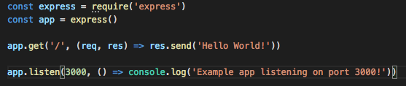
SOA 101 recap
CONCEPTS
What about this one?

Slide 7
SOA 101 recap
CONCEPTS
What about this one?

Slide 8
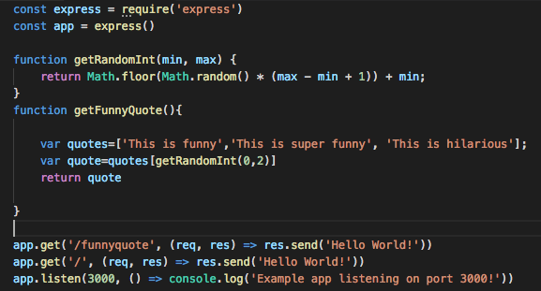
SOA - getting complex
CONCEPTS
What can you tell me about this now?

Slide 9
Monolithic vs SOA
CONCEPTS
This is more like a service
!!!!
MAKE SURE YOU ARE NOT MONOLITHIC
When creating your architecture, you must take into consideration many aspects, and the first one is communication , when do you keep things in one place, when not?
PROS
The application and the code, reside all in the same place, meaning that there is no comunication you need to wait for, also, it is simpler to monitor, and you have less strain on the resources. For example, if you had micro architectures, you may need to replicate the same server many times.
CONS
Things are coupled together, meaning that integration is more difficult, and resources management will not be easy when it will be time to scale. Also, many points of failure unless every point has a solid redundancy plan in place.

Slide 10
Questions?

